Slide 1
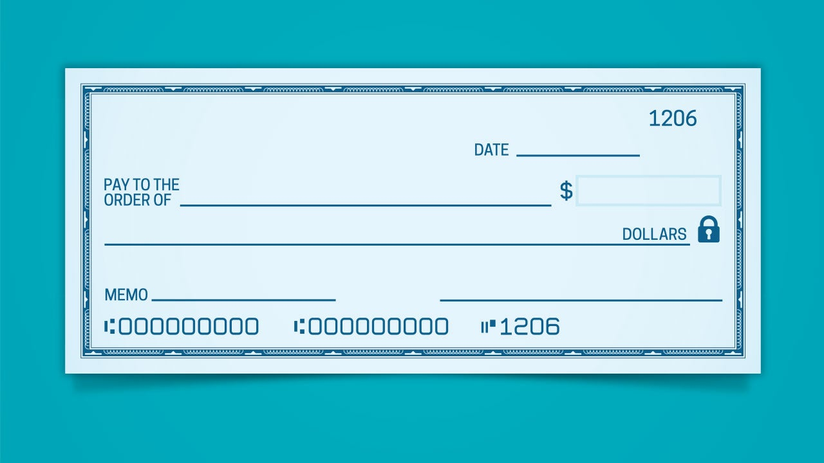

Signature Analysis Shipeng Yang Aditya Vijayvergia

Slide 2
Our goal：
Analysis if a signature is from the check or credit card holder
Provide a new method to verify indentity when login gmail in a new computer

Slide 3


Features from Shipeng Yang
(1)Length of Diagonal
(2)Angle of Diagonal
(3)Max Speed
(4)Max relative speed
(5)Average speed
(6)Average relative speed
(7)Total time
(8)Mid part relative speed

Slide 4
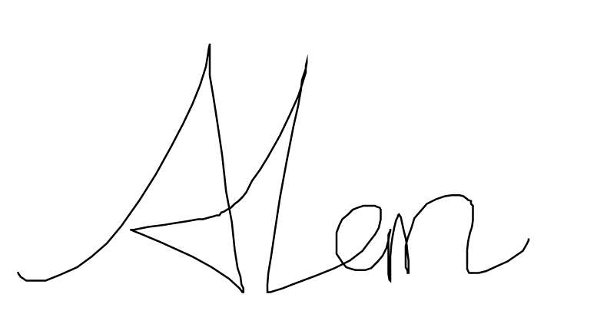
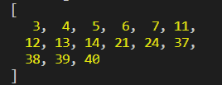

A new match
High speed points match

Slide 5

Segmentation
The algorithm simulates driving a car in high speed on a road in the shape of the stroke and detect collisions.

Slide 6
Algorithm
Step 1: Defining the car-
1. speed
2. maximum steering angle
Step 2 :Getting the vector direction of the road
direction of a vector pointing from a point n points behind the current position of car to the current position of the car

Slide 7
Step 3: Predicting the position of the car after 1 unit time
Assuming straight road
use speed of car and direction of road
Step 4: Detecting turn in road
Angle between predicted road and actual road
This is the angle that the car need to steer to stay on road

Slide 8
Step 5: Checking for segment end
If the angle in step 4 is more than the steering angle of the car, we mark the end of the segment

Slide 9

Extracting features from segments

Slide 10

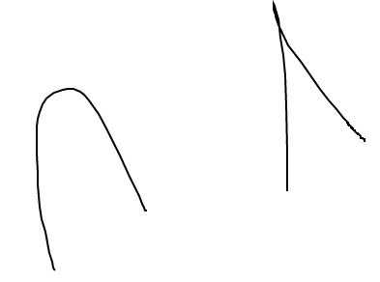
1. Number of segments
Segments break at sharp edges
Similar signatures will have same number of segments

Slide 11
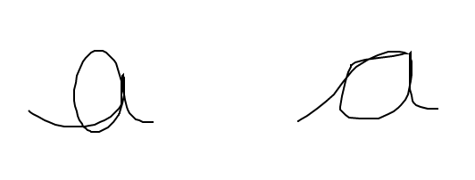
2. Average speed of each segment
Instead of just matching speed of entire signature, we go 1 step ahead and match the speed of each segment
People have different ways of writing different alphabets, copying others makes one slow

Slide 12
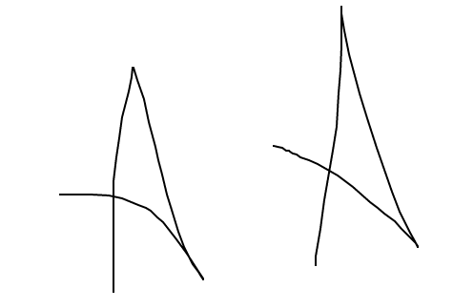
3. Ratio of sum of angles in the segment and sum of absolute angles in the segment
Copied signature differs the original signature in terms of how much a segment curves in any direction

Slide 13


4. Ratio of sum of angles and sum of absolute angles in the whole signature
This features combines with feature 2 (segment-wise ratio of angles) to generate good insight into the signature as a whole

Slide 14
Demo

